Slide 1

Flash Map
Insyde Software March 2021

Slide 2
Copyright 2021 Insyde Software Corp., All Rights Reserved.
No part of this publication may be reproduced, transmitted, transcribed, stored in a retrieval system, or translated into any language or computer language, in any form, or by any means, electronic, mechanical, magnetic, optical, chemical, manual or otherwise, without the prior written permission of Insyde Software Corp.
Disclaimer
Insyde Software Corp. (“Insyde”), provides this document and the programs "as is" without warranty of any kind, either expressed or implied, including, but not limited to, the implied warranties of merchantability or fitness for a particular purpose.
This document may contain technical inaccuracies or typographical errors. Changes are periodically made to the information herein; these changes will be incorporated in future revisions of this document. Insyde is under no obligation to notify any person of the changes. Some code names featured in this document are used to identify products that are in development and not yet publicly announced for release. Insyde is not obligated for its accuracy or completeness.
This document may contain third party’s information, features, schedules, code names, and product names, which are based on Insyde’s interpretation available as of the creation of this document and may be changed from time to time. Neither Insyde nor the third party is obligated to notify such change. If you are interested in third party’s information, you may contact the local third party sales office or the local distributor to obtain the latest specifications. All the intellectual property right of any third party information remains to its owner or steward.

Slide 3
Agenda
Goals & Target Audience
Flash Description File
How to Adjust Flash Layout
How to Change Execution Order
How to Disable Module
Build Report
Internal Use

Slide 4
Goals & Target Audience

Slide 5
Goals & Target Audience
Target Audience:
BIOS developers who use InsydeH2O 5.4 (EDK II) to create their firmware products.
Goals:
Know how to modify Flash Map in InsydeH2O 5.4.
Know how to change the execution order of modules
Requirements:
InsydeH2O 5.4 source code

Slide 6
Flash Description File

Slide 7
FDF File Overview
[FD]
[FV]
[Capsule]
[VTF]
[Rule]
[OptionRom]
[UserExtensions]

Slide 8
FDF File Overview
[FD]
The [FD] sections are made up of the definition statements and a description of what goes into the Flash Device Image.
The section header format is [FD.FdUiName] where the FdUiName can be any value defined by the user.
FD TOKEN Statements
FD Region Layout

Slide 9
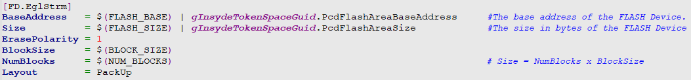
FDF File Overview
[FD] – TOKEN Statements
There are five valid Token names:
BaseAddress: The base address of the FLASH Device.
Size: The size in bytes of the FLASH Device.
ErasePolarity: Either 0 or 1, depending on the erase polarity of the Flash Device.
BlockSize: One or More - Size of a block, optionally followed by number of blocks.
NumBlocks: Zero or one - The number of continuous blocks of size, BlockSize. If NumBlocks is not present, the number of blocks defaults to 1.
Layout: Specifies the layout policy to use. Valid value are: Default, PackUp, PackDown and Report.

Slide 10
FDF File Overview
[FD] – Region Layout
The format for an FD Layout Region is:
Offset|Size
[TokenSpaceGuidCName.PcdOffsetCName|TokenSpaceGuidCName.PcdSizeCName]
[RegionType]
[RegionContents]
Region Contents:
FV
DATA
FILE
No RegionType Specified

Slide 11
FDF File Overview
[FD] – Region Layout

Slide 12
FDF File Overview
[FV]
The [FV] section defines what components or modules are placed within a flash device file.
These sections define the order the components and modules are positioned within the image.
The format for [FV] section header is:
[FV.UiFvName]
The FV UiFvName must be unique for every declared user defined name within the file.

Slide 13
FDF File Overview
[FV] – INF Statements
The INF statements point to EDK component and EDK II module INF files.
The format for INF statements is:
INF [Options] PathAndInfFileName
[FV.RECOVERYFV]
INF InsydeModulePkg/Core/DxeIplPeim/DxeIpl.inf

Slide 14
FDF File Overview
[FV] – FILE Statements
FILE statements are provided so that a platform integrator can include complete EFI FFS files, as well as a method for constructing FFS files using curly "{}" brace scoping.
FFS file specification syntax is one of the following:
FILE Type $(NAMED_GUID) [Options] FileName
OR
FILE Type $(NAMED_GUID) [Options] {
SECTION SECTION_TYPE = FileName
}
FILE FREEFORM = 96DCE314-3628-4256-A02E-3B10C61D85FD {
SECTION RAW = InsydeModulePkg/Universal/Console/Logo/Insyde/InsydeLogo.tga
}

Slide 15
FDF File Overview
[Rule]
The optional [Rule] sections in the FDF file are used for combining binary images, not for compiling code.
The [Rule] section of the FDF file is used to define custom rules, which may be applied to a given INF file listed in an [FV] section.
[Rule.ARCH.MODULE_TYPE.TEMPLATE_NAME]
The TEMPLATE_NAME must be unique to the ARCH and MODULE_TYPE.
INF RuleOverride=LzmaCompress InsydeModulePkg/Bus/Pci/AhciBusPei/AhciBusPei.inf
[Rule.Common.PEIM.LzmaCompress]
FILE PEIM = $(NAMED_GUID) {
PEI_DEPEX PEI_DEPEX Optional $(INF_OUTPUT)/$(MODULE_NAME).depex
GUIDED EE4E5898-3914-4259-9D6E-DC7BD79403CF {
PE32 PE32 $(INF_OUTPUT)/$(MODULE_NAME).efi
UI STRING="$(MODULE_NAME)" Optional
VERSION STRING="$(INF_VERSION)" Optional BUILD_NUM=$(BUILD_NUMBER)
}
}

Slide 16
FDF File Overview
!import
!import fdf-path
This command acts as if the contents from each section in the specified .fdf file were merged together and the section contents in project.fdf are put after section contents of all the imported packages.
The !import command can only be used in a project’s .fdf file.
!import MdeModulePkg/Package.fdf
!disable
!disable file-path
This command disables the specified module, removing it from the current FV.
!disable InsydeModulePkg/Bus/Pci/EhciPei/EhciPei.inf

Slide 17
How to Adjust Flash Layout

Slide 18
Change the Size of BIOS Binary
Board/Intel/$(PROJECT_PKG)/Project.fdf
[FD.Eglstrm]
BaseAddress = $(FLASH_BASE) | gInsydeTokenSpaceGuid.PcdFlashAreaBaseAddress
Size = $(FLASH_SIZE) | gInsydeTokenSpaceGuid.PcdFlashAreaSize
ErasePolarity = 1
BlockSize = $(BLOCK_SIZE)
NumBlocks = $(NUM_BLOCKS)
Board/Intel/$(PROJECT_PKG)/FlashRegionDefines.fdf
DEFINE FLASH_BASE = 0xFF000000
DEFINE FLASH_SIZE = 0x01000000
DEFINE NUM_BLOCKS = $(FLASH_SIZE)/$(BLOCK_SIZE)
DEFINE FLASH_REGION_FV_RECOVERY_SIZE = 0x00400000 - $(FLASH_REGION_FV_FSP_SIZE)
DEFINE FLASH_REGION_FV_RECOVERY_OFFSET = $(FLASH_SIZE) - $(FLASH_REGION_FV_RECOVERY_SIZE)

Slide 19
Change the Size of Defined Regions
Board/Intel/$(PROJECT_PKG)/FlashRegionDefines.fdf
DEFINE FLASH_REGION_NVSTORAGE_SUBREGION_NV_VARIABLE_STORE_OFFSET =
$(FLASH_REGION_BIOS_EVENT_STORAGE_OFFSET) + $(FLASH_REGION_BIOS_EVENT_STORAGE_SIZE)
DEFINE FLASH_REGION_NVSTORAGE_SUBREGION_NV_VARIABLE_STORE_SIZE = 0x00019000
DEFINE FLASH_REGION_NV_COMMON_STORE_SUBREGION_MICROCODE_OFFSET =
$(FLASH_REGION_BIOSACM_OFFSET) + $(FLASH_REGION_BIOSACM_SIZE)
DEFINE FLASH_REGION_NV_COMMON_STORE_SUBREGION_MICROCODE_SIZE = 0x00040000

Slide 20
Add New Region
Board/Intel/$(PROJECT_PKG)/FlashRegionDefines.fdf
DEFINE FLASH_REGION_ODM_DATA_OFFSET = $(FLASH_REGION_NVSTORAGE_SUBREGION_NV_FACTORY_COPY_OFFSET) + $(FLASH_REGION_NVSTORAGE_SUBREGION_NV_FACTORY_COPY_SIZE)
DEFINE FLASH_REGION_ODM_DATA_SIZE = 0x00010000
DEFINE FLASH_REGION_FV_BACKUP_OFFSET = $(FLASH_REGION_ODM_DATA_OFFSET) + (FLASH_REGION_ODM_DATA_SIZE)
DEFINE FLASH_REGION_FV_BACKUP_SIZE = 0x00020000
$(FLASH_REGION_ODM_DATA_OFFSET)|$(FLASH_REGION_ODM_DATA_SIZE)
gOdmTokenSpaceGuid.PcdFlashOdmDataBase|gOdmTokenSpaceGuid.PcdFlashOdmDataSize
Board/Intel/$(PROJECT_PKG)/Project.dec
gOdmTokenSpaceGuid = {…}
gOdmTokenSpaceGuid.PcdFlashOdmDataBase|0x00000000|UINT32|0x00000001
gOdmTokenSpaceGuid.PcdFlashOdmDataSize|0x00000000|UINT32|0x00000002

Slide 21
How to Change Execution Order

Slide 22
How to Change Execution Order
APRIORI File
Location within Firmware Volume
Dependency Expression

Slide 23
APRIORI File
APRIORI File
APRIORI [= number]
0x100 – 0xff00
Higher number appearing earlier and lower numbers later
If APRIORI is not present and the file does not appear in an APRIORI section, then its name will not be listed in the apriori file.
If number is not present, the default value is 0x8000
InsydeModulePkg/Package.fdf
INF APRIORI=0xC000 InsydeModulePkg/H2ODebug/DebugEnginePei/DebugEnginePei.inf
INF APRIORI InsydeModulePkg/Universal/StatusCodeHandler/DdtStatusCodePei/DdtStatusCodePei.inf
INF InsydeModulePkg/Universal/Variable/VariablePei/VariablePei.inf

Slide 24
Location within Firmware Volume
PRIORITY = number
0x100 – 0xff00
Higher numbers are placed first, lower numbers are placed later.
If PRIORITY is not present, the default value is 0x8000.

Slide 25
Location within Firmware Volume
Board\Intel\$(PROJECT_PKG)\Project.fdf
INF PRIORITY=0x8003 ServerPlatformPkg/Uba/CfgDb/Pei/CfgDbPei.inf
INF PRIORITY=0x8003 $(PROJECT_PKG)/Uba/BoardInit/Pei/BoardInitPei.inf
INF PRIORITY=0x8001 $(PROJECT_PKG)/Uba/UbaUpdatePcds/Pei/UpdatePcdsPei.inf
RECOVERYFV.Fv.txt
START | END | FILE NAME
0xFFC06268 | 0xFFC0835F | UbaConfigDatabasePei
0xFFC083E8 | 0xFFC1FDAF | BoardInitPeim
0xFFC2A4E8 | 0xFFC2B8CF | UpdatePcdPei

Slide 26
Dependency Expression – Module Dependency
InsydeModulePkg/Universal/Variable/VariableRuntimeDxe/
VariableRuntimeDxe.inf
[Depex]
<DXE_DEPEX>
gEfiFirmwareVolumeBlockProtocolGuid AND
gEfiAlternateFvBlockGuid AND
gEfiFaultTolerantWriteLiteProtocolGuid
<SMM_DEPEX>
gEfiNonVolatileVariableProtocolGuid AND
gEfiSmmFtwProtocolGuid AND
gEfiSmmSwDispatch2ProtocolGuid AND
gEfiSmmCpuProtocolGuid

Slide 27
Dependency Expression – Library Instance Dependency
Library Instance might have dependency rule defined by the [Depex] section in the INF file
The dependency rule of the Library Instance will be added to the driver dependency if it is linked by the driver

Slide 28
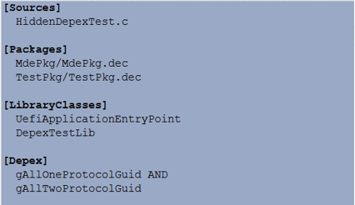
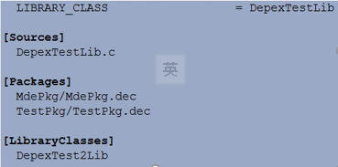
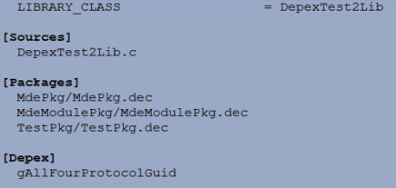
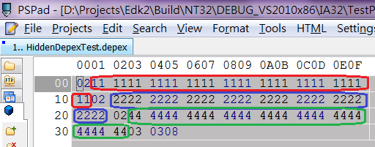
Dependency Expression – Library Instance Dependency
HiddenDepexTest.inf
DepexTestLib.inf
DepexTest2Lib.inf
Dependency output

Slide 29
How to Disable Module

Slide 30
How to Disable Module
Remove
You don’t want to use Kernel’s driver
!disable MdeModulePkg/Core/Pei/PeiMain.inf
Modify
You want to modify Kernel’s Ps2Keyboard driver
!disable InsydeModulePkg/Bus/Isa/Ps2KeyboardDxe/Ps2keyboardDxe.inf
InsydeModulePkg/Bus/Isa/Ps2KeyboardDxe/Ps2keyboardDxe.inf {
<SOURCE_OVERRIDE_PATH>
$(PROJECT_PKG)/Override/Insyde/InsydeModulePkg/Bus/Isa/Ps2KeyboardDxe
}

Slide 31
Build Report

Slide 32
Build Report
$(WORKSPACE)/Build/$(PROJECT_PKG)/$(BUILD_TARGET)_$(TOOL_CHAIN)/FV/
XxxFV.Fv.txt
EFI_FV_NAME = RECOVERYFV.Fv
EFI_FV_BASE_ADDRESS = 0xFFC00000
EFI_FV_TOTAL_SIZE = 0x400000 ( 4.00M)
…
RECOVERYFV.Fv [90%] 4194304 ( 4.00M) total, 3796216 ( 3.62M) Used, 398088 (388.75K) free

Slide 33
Build Report
$(WORKSPACE)/Build/$(PROJECT_PKG)/BuildReport.txt
Platform Configuration Database Report
…
gEfiMdeModulePkgTokenSpaceGuid
*P PcdPlatformType : FIXED (UINT8) = 2
DEC DEFAULT = 0
…
Module Summary
Module Name: PeiCore
Module INF Path: MdeModulePkg\Core\Pei\PeiMain.inf
File GUID: 52C05B14-0B98-496c-BC3B-04B50211D680
Size: 0x9940 (38.31K)
Build Time Stamp: 1970-01-01 08:00:00
Module Build Time: 8104ms
Driver Type: 0x4 (PEI_CORE)
…

Slide 34
Thanks!

